Slide 1
TEAM MEMBERS
KARAN RAJESHBHAI TRIVEDI
SRI VAMSHI POLELA
JOAO PEDRO JACOMOSSI
NIKROSHITHA A NOTANI

Slide 2
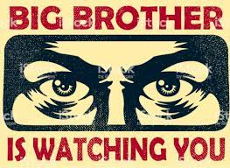

Slide 3
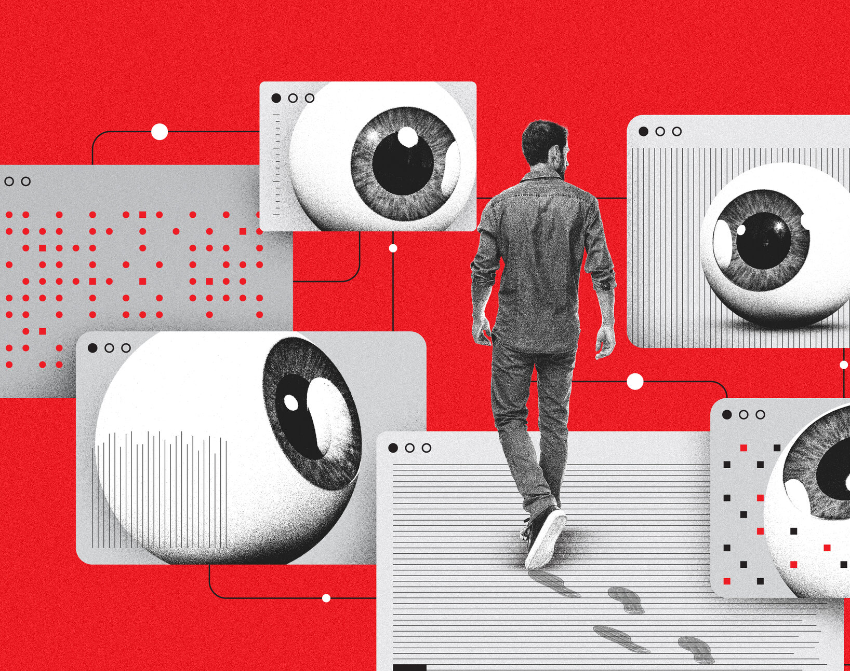
Monitoring and Surveillance In Analytics

Slide 4
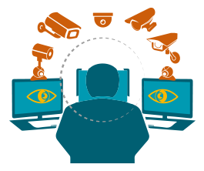
What is the difference between Surveillance and Monitoring?

Slide 5

Definitions
Surveillance is an active kind of search where the issue under observation is continuously and actively under the radar.
Monitoring is a passive process wherein the data collected regarding any disease or other matter is monitored on a weekly/monthly /quarterly/yearly basis.

Slide 6

History of Survelliance and Monitoring
The first documented use of surveillance cameras was in Soviet Russia during the Stalin era.
In 1927, a Russian scientist named Léon Theremin invented a simple wireless system that connected a video camera and television together.
It was eventually used to watch visitors coming to the Kremlin in Moscow.

Slide 7
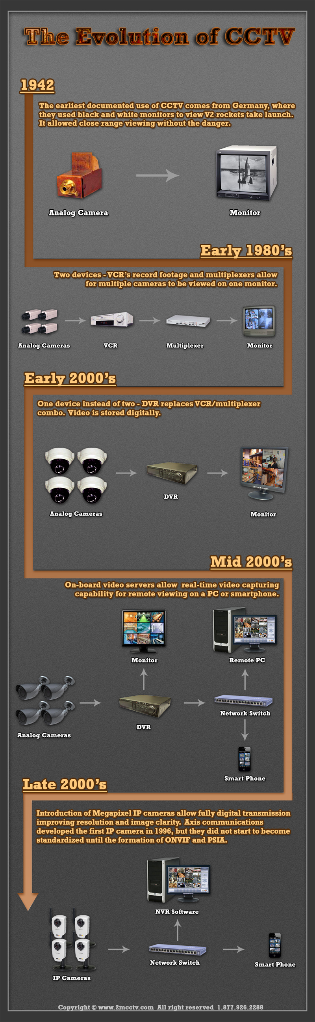
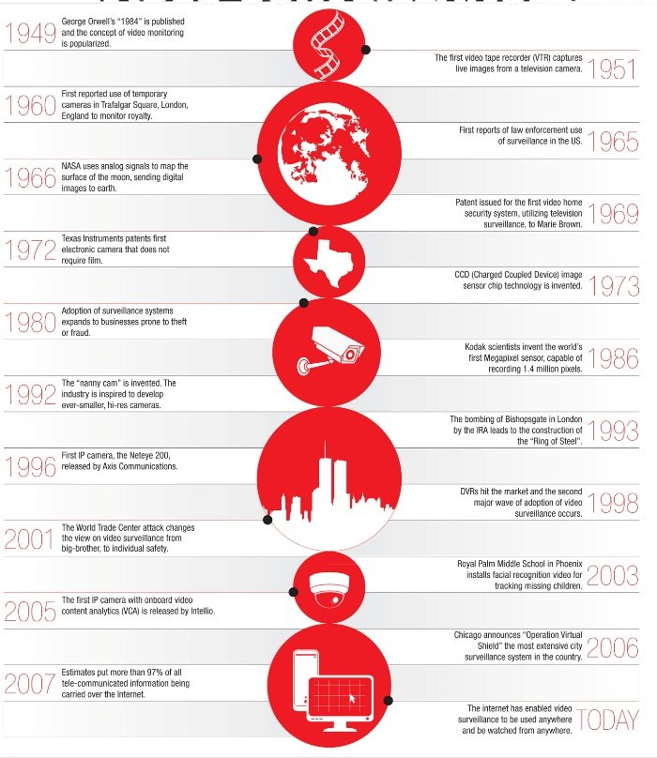

Slide 8
How is this technology used today
Nowadays advanced surveillance cameras, face recognition, biometrics, tracking devices, and drones are common aspects of our daily life.
By monitoring and surveilling people, ethical implications arise. Some of them are the degree of transparency of data being collected and its purpose, means of collection, awareness of individuals, consent, consequences of the activity, and conflict of interest

Slide 9
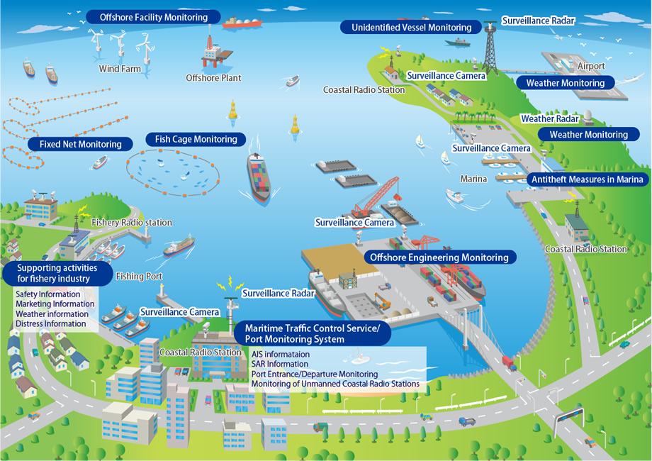
Major areas using this technology
Environmental monitoring systems.
Animal health data.
Information provided from individuals.
Information from laboratories
Medical records at outpatient healthcare facilities, as well as hospitals.

Slide 10
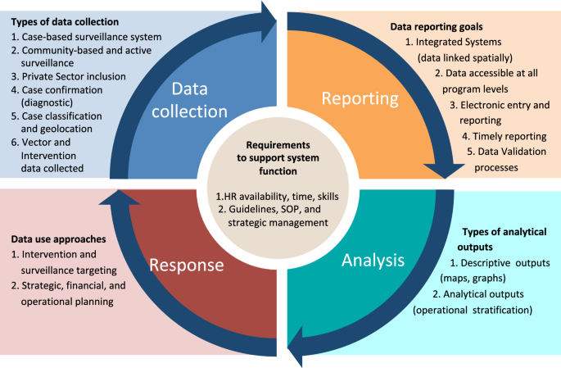
Types
Passive
Active
Syndromic

Slide 11
PASSIVE
Passive surveillance is the most common form of surveillance and occurs when laboratories, physicians, or other healthcare providers regularly report cases or disease to the local health department.
These reports are based on standard case definitions for a particular disease or condition.

Slide 12
ACTIVE
A second form of surveillance is active surveillance. This occurs when the collection of data from the lab, physician, or other healthcare provider is initiated by the health department.
Active surveillance is often used during outbreak investigations or research studies.
Active surveillance has an advantage over passive
surveillance because it achieves more complete and accurate reporting.

Slide 13
SYNDROMIC
A third type of surveillance is syndromic surveillance. It is defined as the ongoing, systematic collection, analysis, interpretation, and application of real-time indicators for disease that allow for detection before public health authorities would otherwise identify them.
Syndromic surveillance data are collected
in real time, meaning that the data are automated so that they can be received daily, or even more frequently.

Slide 14
Question Arising with concerns
Why is this data collected ? What are its outcomes?
Where will this data stay ? Is it public use or under any organisation?
What can be the emotional burdens or benefits of living in a surveillance-obsessed society?
What exactly is going on with the Surveillance Camera Man?

Slide 15
How does it create negative impacts?
Monitoring and surveillance when conducted in a way that is opaque, unfair, dishonest, and apathetic can be harmful for the people subject to it.
Having a watch on someone’s daily activity is unethical.
According to Thiel, those who are often monitored lose their sense of control over their own choices, which leads to a loss of moral responsibility.
Therefore, when there is no longer moral responsibility, deviance occurs.

Slide 16
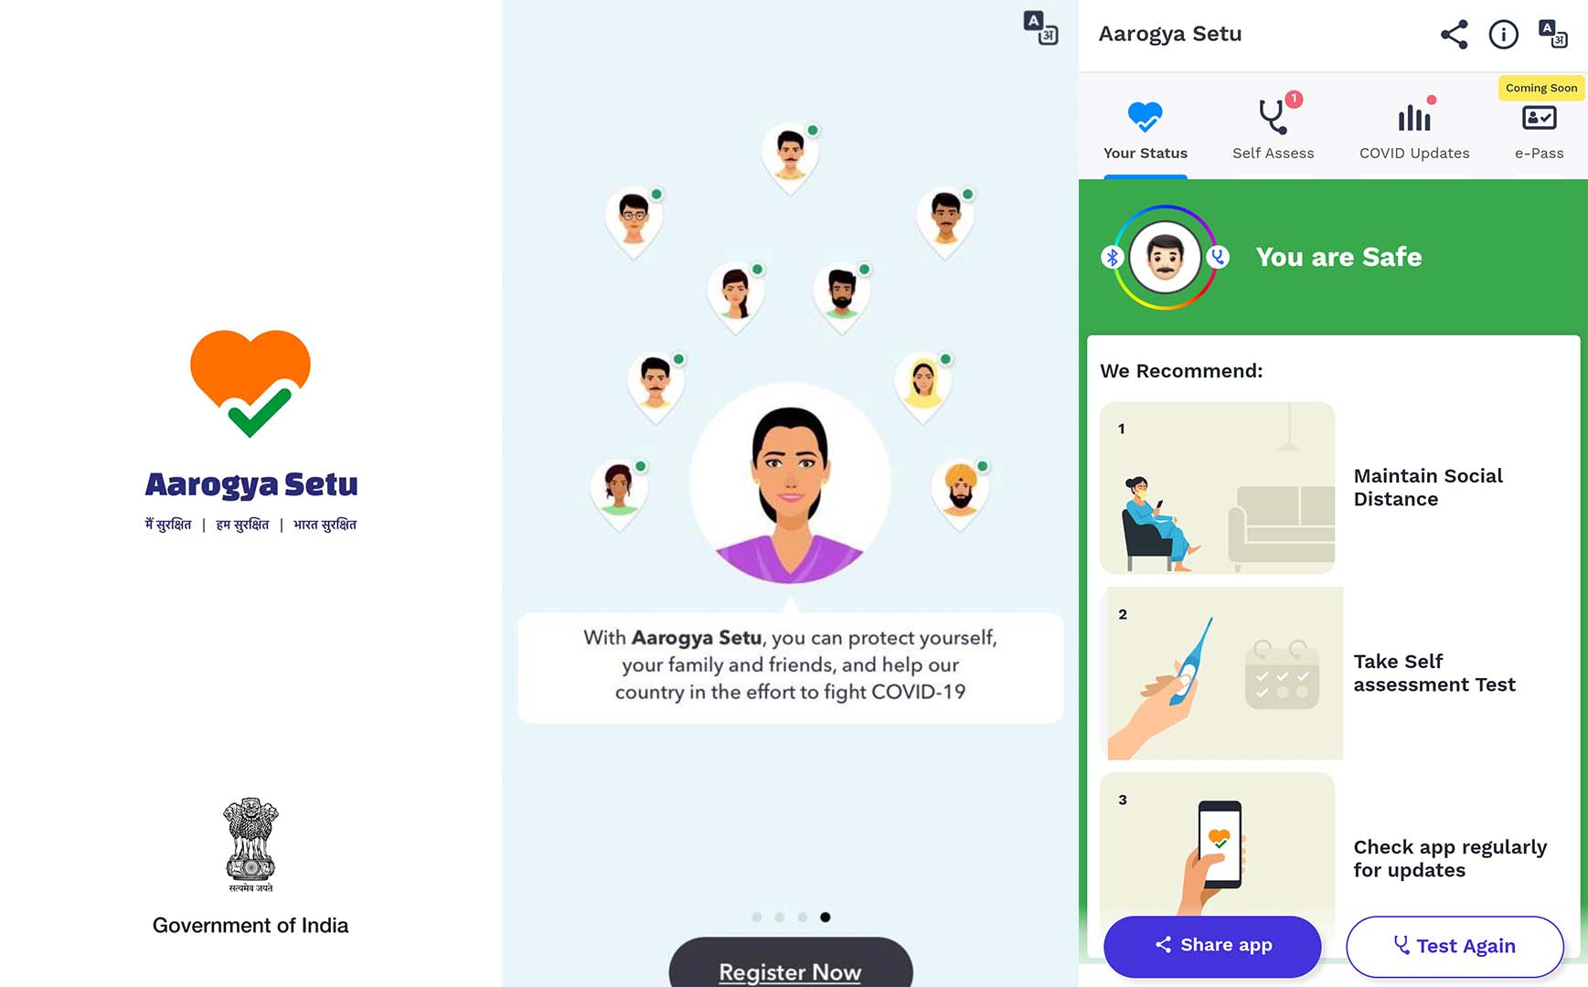
Monitoring Data – Public Health
We have recognized that surveillance technologies have been useful and well-intentioned at some stages, the best examples – are health surveillance.
During COVID we used to receive daily updates on infected patients with the predicted number. How were we collecting the data? One of the mobile applications used by Indian Government was Arogya Setu

Slide 17
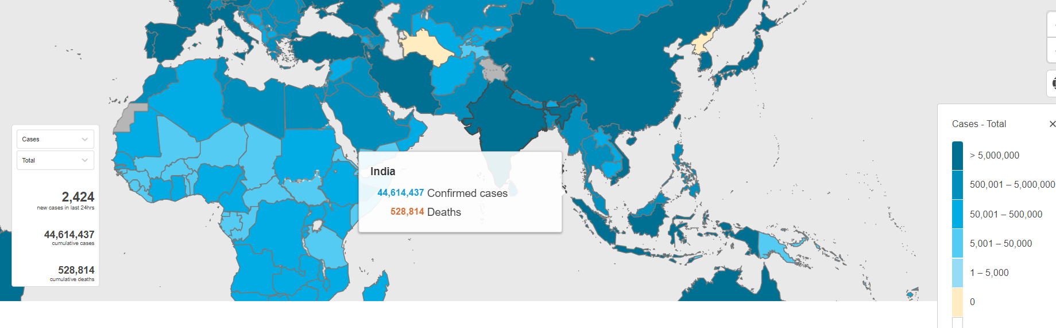
Picture taken from WHO site - https://covid19.who.int/region/searo/country/in

Slide 18
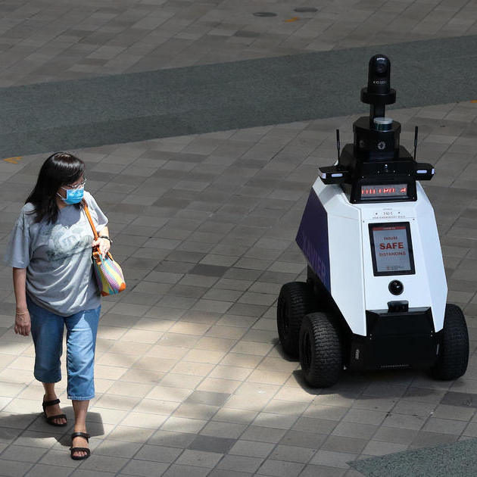
Robots Advancements
Another important concern is that digitally enabled surveillance technologies can provide a wider range of information than initially intended, enabling what is known as ‘function creep’
Most advanced robots, for example, are equipped with sensors and actuators that collect, transmit and process a vast amount of data in real time.

Slide 19
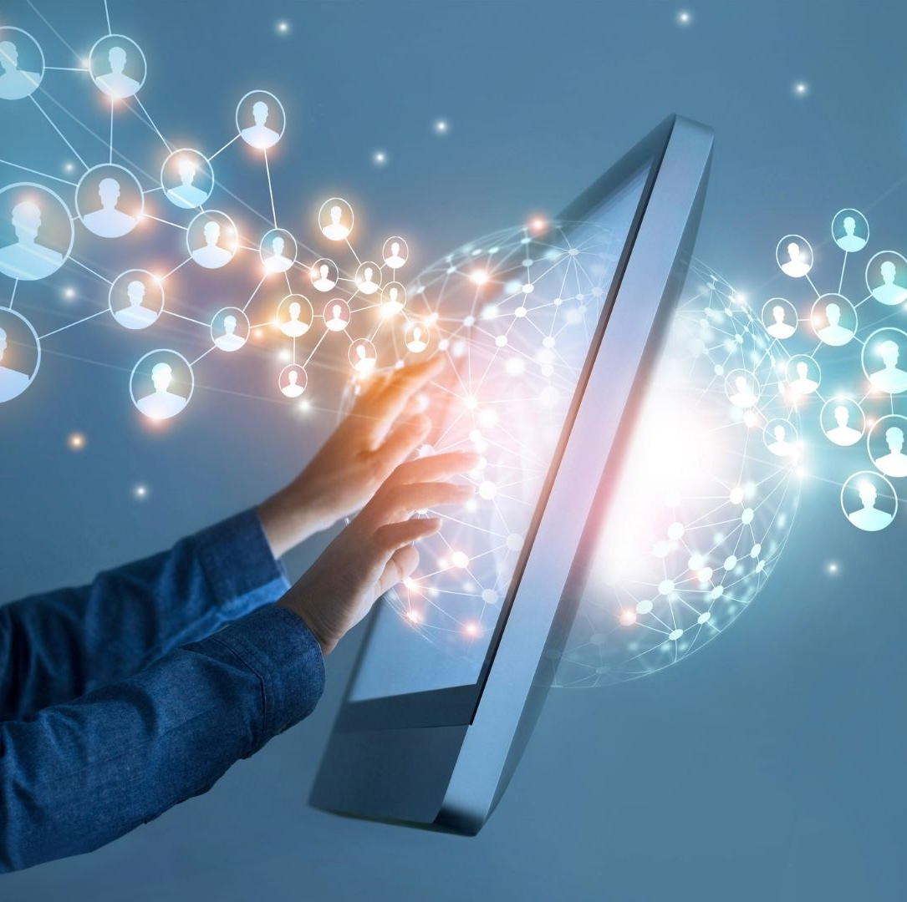
Banking Sector
In Banking, Monitoring is essential to prevent insider trading and to comply with regulatory requirements.
Digital tracking technologies may provide greater security for workers who are required to travel extensively or to work alone as part of their job.

Slide 20
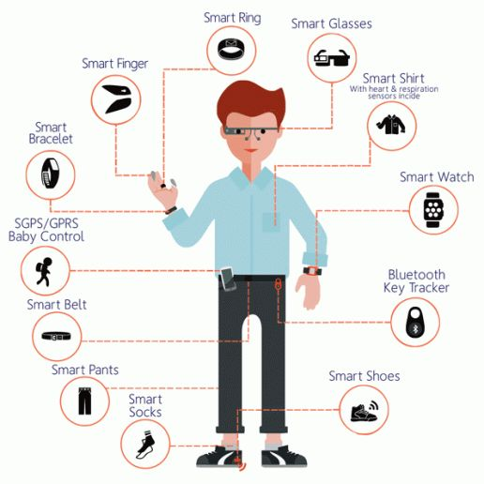
Analytics in Wearables
The use of wearables and biometric technologies – which are slowly but surely entering the world of work – can take monitoring and surveillance to a new level by increasing the level of control and factoring personal characteristics as part of the monitoring.
In this area, rapid developments in AI technologies are enabling so-called ‘people analytics’ and ‘profiling’

Slide 21

Implementation before the rise of negative impacts
Confirming the importance of ethics in monitoring and surveillance, the next step is to identify ways to put it into practice.
The first category questions if the activity causes harm, crosses personal boundaries, or if it violates trust in any way.
The second category reflects on awareness (are individuals aware that their data is being collected and why?, are they aware of the results and how it was created?
The third category asks questions regarding the use of surveillance data.

Slide 22
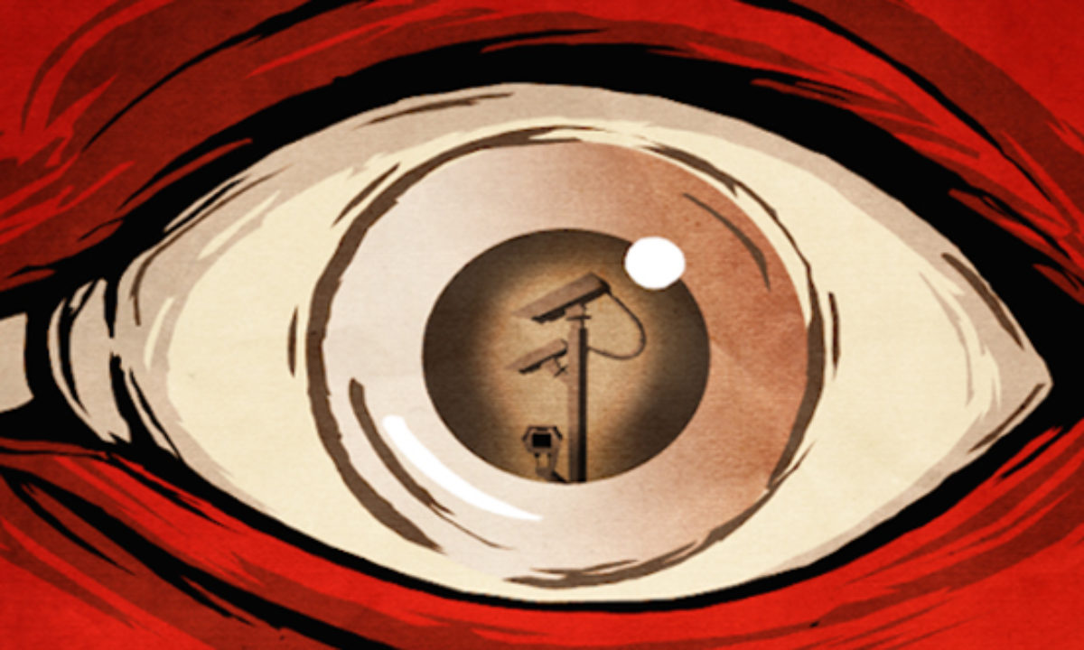
Conclusion
Following these steps is an effective way to reconcile monitoring and surveillance processes with those subject to it in a way that minimizes ethical issues and improves people’s attitudes towards the matter.
Therefore, drawing the line between survelliance with monitoring and spying by providing transparency is most beneficial for both parties.

Slide 23
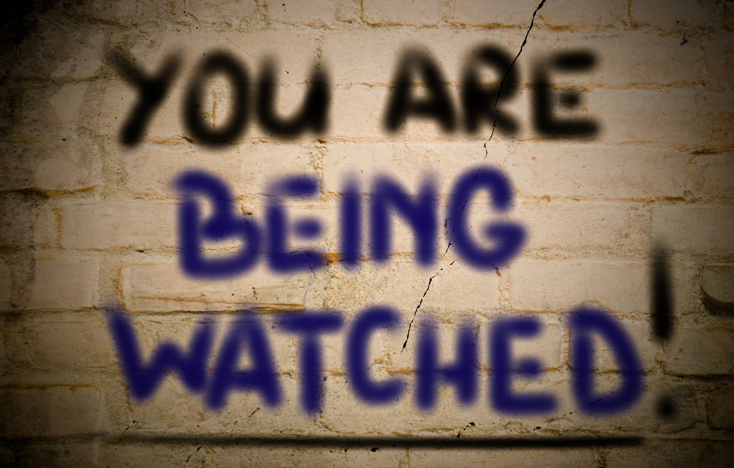

Slide 24


Slide 25


